Slide 1
The countability of
the rational numbers

Slide 2
The countability of
the rational numbers
We already know some key facts about set equinumerosity (cardinality):

Slide 3
The countability of
the rational numbers
We already know some key facts about set equinumerosity (cardinality):
Two sets have the same cardinality if there exists a one-to-one pairing
between all elements of the sets.

Slide 4
The countability of
the rational numbers
We already know some key facts about set equinumerosity (cardinality):
Two sets have the same cardinality if there exists a one-to-one pairing
between all elements of the sets.
Sets do not have the same cardinality, if such a pairing does not exist.

Slide 5
The countability of
the rational numbers
We already know some key facts about set equinumerosity (cardinality):
Two sets have the same cardinality if there exists a one-to-one pairing
between all elements of the sets.
Sets do not have the same cardinality, if such a pairing does not exist.
Adding finitely many elements doesn’t change an inifnite set’s cardinality.

Slide 6
The countability of
the rational numbers
We already know some key facts about set equinumerosity (cardinality):
Two sets have the same cardinality if there exists a one-to-one pairing
between all elements of the sets.
Sets do not have the same cardinality, if such a pairing does not exist.
Adding finitely many elements doesn’t change an inifnite set’s cardinality.
If for two sets $A$ and $B$, $A⊆B$ and you can enumerate $B$ using elements
of $A$, then the sets $A$ and $B$ have the same cardinality.

Slide 7
The countability of
the rational numbers
We already know some key facts about set equinumerosity (cardinality):
Two sets have the same cardinality if there exists a one-to-one pairing
between all elements of the sets.
Sets do not have the same cardinality, if such a pairing does not exist.
Adding finitely many elements doesn’t change an inifnite set’s cardinality.
If for two sets $A$ and $B$, $A⊆B$ and you can enumerate $B$ using elements
of $A$, then the sets $A$ and $B$ have the same cardinality.
Every infinite subset of natural numbers is equinumerous with ℕ itself.

Slide 8
The countability of
the rational numbers
At first glance, the set of rational numbers appears "infinitely larger"
than natural numbers:

Slide 9
The countability of
the rational numbers
At first glance, the set of rational numbers appears "infinitely larger"
than natural numbers:

Slide 10
The countability of
the rational numbers
At first glance, the set of rational numbers appears "infinitely larger"
than natural numbers:
Natural numbers (and integers) are a subset of rational numbers, i.e. $ℕ⊂ℚ$.

Slide 11
The countability of
the rational numbers
At first glance, the set of rational numbers appears "infinitely larger"
than natural numbers:
Natural numbers (and integers) are a subset of rational numbers, i.e. $ℕ⊂ℚ$.
Between any two integers, there are infinitely many rational numbers

Slide 12
The countability of
the rational numbers
At first glance, the set of rational numbers appears "infinitely larger"
than natural numbers:
Natural numbers (and integers) are a subset of rational numbers, i.e. $ℕ⊂ℚ$.
Between any two integers, there are infinitely many rational numbers
Equinumerosity occurs if all these rational numbers can be numbered.

Slide 13
The countability of
the rational numbers
Proof that Rational Numbers are Countable:

Slide 14
The countability of
the rational numbers
Proof that Rational Numbers are Countable:
We will use the diagonal method:

Slide 15
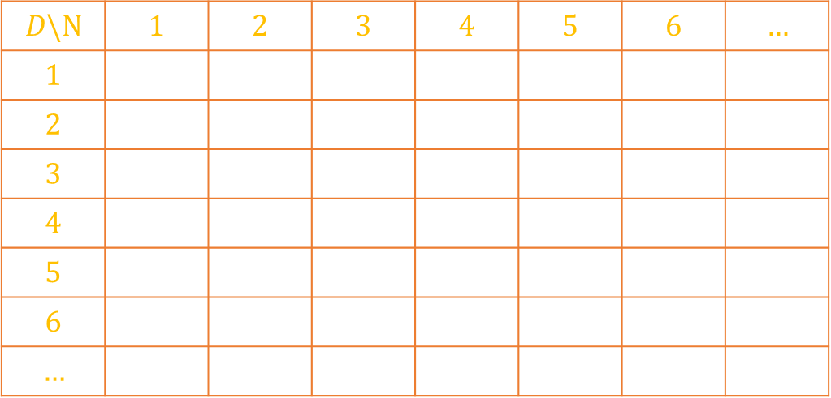
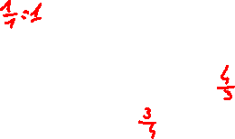
The countability of
the rational numbers
Proof that Rational Numbers are Countable:
We will use the diagonal method:
$$D\backslash N$$ | $$1$$ | $$2$$ | $$3$$ | $$4$$ | $$5$$ | $$6$$ | $$…$$
$$1$$
$$2$$
$$3$$
$$4$$
$$5$$
$$6$$
$$…$$

Slide 16
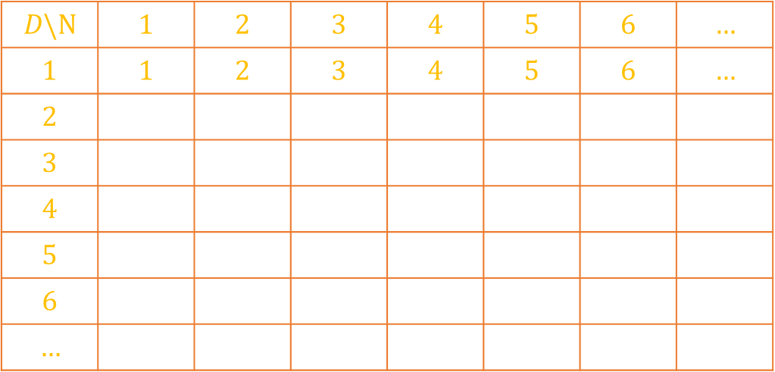
The countability of
the rational numbers
$$D\backslash N$$ | $$1$$ | $$2$$ | $$3$$ | $$4$$ | $$5$$ | $$6$$ | $$…$$
$$1$$ | $$1$$ | $$2$$ | $$3$$ | $$4$$ | $$5$$ | $$6$$ | $$…$$
$$2$$
$$3$$
$$4$$
$$5$$
$$6$$
$$…$$

Slide 17
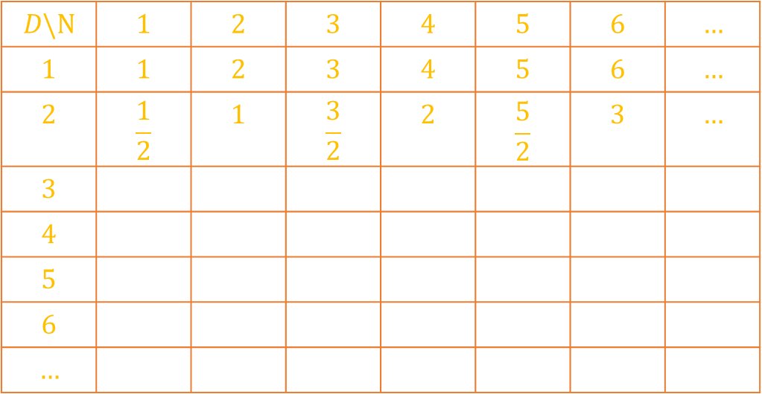
The countability of
the rational numbers
$$D\backslash N$$ | $$1$$ | $$2$$ | $$3$$ | $$4$$ | $$5$$ | $$6$$ | $$…$$
$$1$$ | $$1$$ | $$2$$ | $$3$$ | $$4$$ | $$5$$ | $$6$$ | $$…$$
$$2$$ | $$\frac{1}{2}$$ | $$1$$ | $$\frac{3}{2}$$ | $$2$$ | $$\frac{5}{2}$$ | $$3$$ | $$…$$
$$3$$
$$4$$
$$5$$
$$6$$
$$…$$

Slide 18
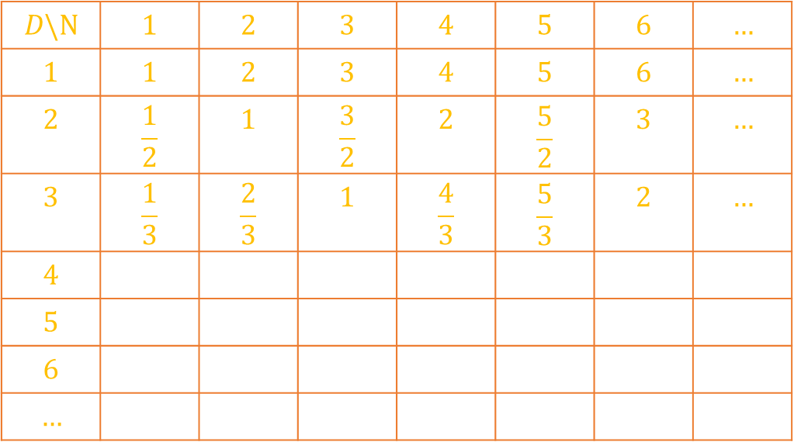
The countability of
the rational numbers
$$D\backslash N$$ | $$1$$ | $$2$$ | $$3$$ | $$4$$ | $$5$$ | $$6$$ | $$…$$
$$1$$ | $$1$$ | $$2$$ | $$3$$ | $$4$$ | $$5$$ | $$6$$ | $$…$$
$$2$$ | $$\frac{1}{2}$$ | $$1$$ | $$\frac{3}{2}$$ | $$2$$ | $$\frac{5}{2}$$ | $$3$$ | $$…$$
$$3$$ | $$\frac{1}{3}$$ | $$\frac{2}{3}$$ | $$1$$ | $$\frac{4}{3}$$ | $$\frac{5}{3}$$ | $$2$$ | $$…$$
$$4$$
$$5$$
$$6$$
$$…$$

Slide 19
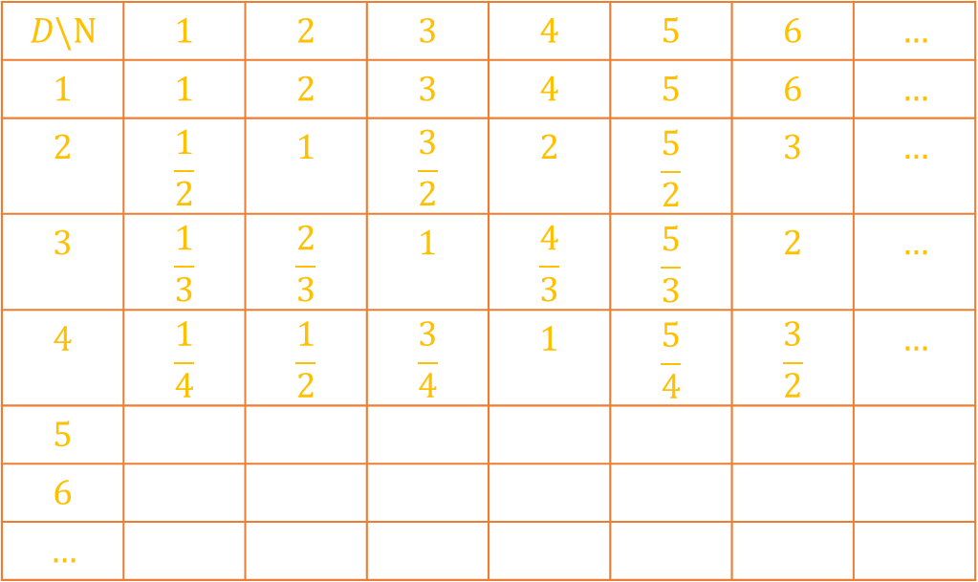
The countability of
the rational numbers
$$D\backslash N$$ | $$1$$ | $$2$$ | $$3$$ | $$4$$ | $$5$$ | $$6$$ | $$…$$
$$1$$ | $$1$$ | $$2$$ | $$3$$ | $$4$$ | $$5$$ | $$6$$ | $$…$$
$$2$$ | $$\frac{1}{2}$$ | $$1$$ | $$\frac{3}{2}$$ | $$2$$ | $$\frac{5}{2}$$ | $$3$$ | $$…$$
$$3$$ | $$\frac{1}{3}$$ | $$\frac{2}{3}$$ | $$1$$ | $$\frac{4}{3}$$ | $$\frac{5}{3}$$ | $$2$$ | $$…$$
$$4$$ | $$\frac{1}{4}$$ | $$\frac{1}{2}$$ | $$\frac{3}{4}$$ | $$1$$ | $$\frac{5}{4}$$ | $$\frac{3}{2}$$ | $$…$$
$$5$$
$$6$$
$$…$$

Slide 20
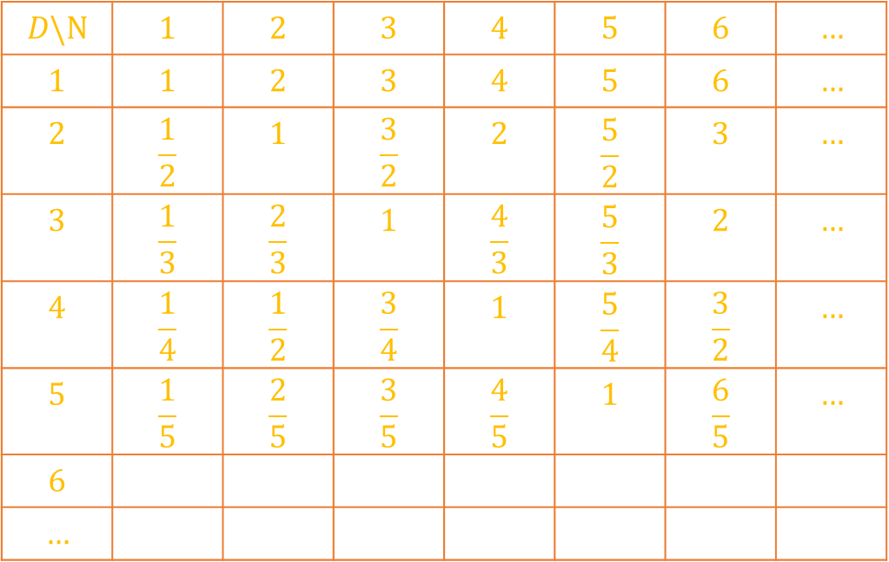
The countability of
the rational numbers
$$D\backslash N$$ | $$1$$ | $$2$$ | $$3$$ | $$4$$ | $$5$$ | $$6$$ | $$…$$
$$1$$ | $$1$$ | $$2$$ | $$3$$ | $$4$$ | $$5$$ | $$6$$ | $$…$$
$$2$$ | $$\frac{1}{2}$$ | $$1$$ | $$\frac{3}{2}$$ | $$2$$ | $$\frac{5}{2}$$ | $$3$$ | $$…$$
$$3$$ | $$\frac{1}{3}$$ | $$\frac{2}{3}$$ | $$1$$ | $$\frac{4}{3}$$ | $$\frac{5}{3}$$ | $$2$$ | $$…$$
$$4$$ | $$\frac{1}{4}$$ | $$\frac{1}{2}$$ | $$\frac{3}{4}$$ | $$1$$ | $$\frac{5}{4}$$ | $$\frac{3}{2}$$ | $$…$$
$$5$$ | $$\frac{1}{5}$$ | $$\frac{2}{5}$$ | $$\frac{3}{5}$$ | $$\frac{4}{5}$$ | $$1$$ | $$\frac{6}{5}$$ | $$…$$
$$6$$
$$…$$

Slide 21
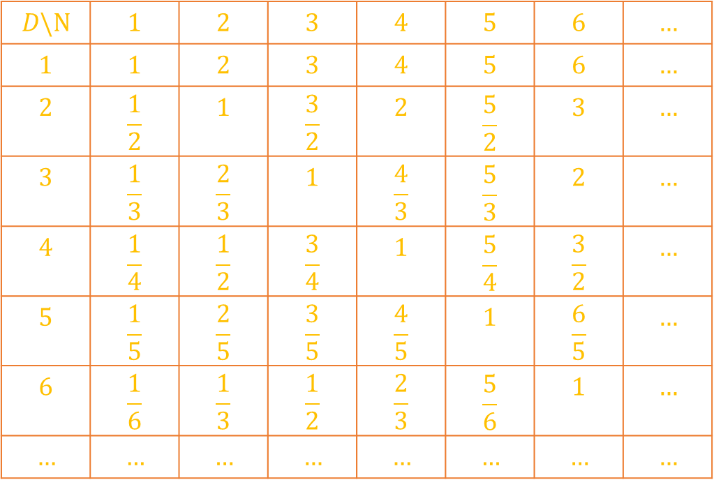

The countability of
the rational numbers
$$D\backslash N$$ | $$1$$ | $$2$$ | $$3$$ | $$4$$ | $$5$$ | $$6$$ | $$…$$
$$1$$ | $$1$$ | $$2$$ | $$3$$ | $$4$$ | $$5$$ | $$6$$ | $$…$$
$$2$$ | $$\frac{1}{2}$$ | $$1$$ | $$\frac{3}{2}$$ | $$2$$ | $$\frac{5}{2}$$ | $$3$$ | $$…$$
$$3$$ | $$\frac{1}{3}$$ | $$\frac{2}{3}$$ | $$1$$ | $$\frac{4}{3}$$ | $$\frac{5}{3}$$ | $$2$$ | $$…$$
$$4$$ | $$\frac{1}{4}$$ | $$\frac{1}{2}$$ | $$\frac{3}{4}$$ | $$1$$ | $$\frac{5}{4}$$ | $$\frac{3}{2}$$ | $$…$$
$$5$$ | $$\frac{1}{5}$$ | $$\frac{2}{5}$$ | $$\frac{3}{5}$$ | $$\frac{4}{5}$$ | $$1$$ | $$\frac{6}{5}$$ | $$…$$
$$6$$ | $$\frac{1}{6}$$ | $$\frac{1}{3}$$ | $$\frac{1}{2}$$ | $$\frac{2}{3}$$ | $$\frac{5}{6}$$ | $$1$$ | $$…$$
$$…$$ | $$…$$ | $$…$$ | $$…$$ | $$…$$ | $$…$$ | $$…$$ | $$…$$

Slide 22
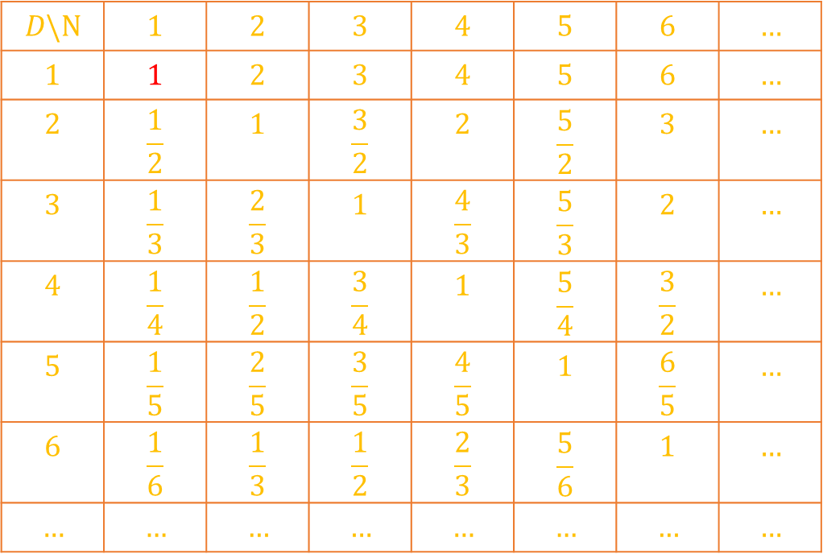
The countability of
the rational numbers
$$D\backslash N$$ | $$1$$ | $$2$$ | $$3$$ | $$4$$ | $$5$$ | $$6$$ | $$…$$
$$1$$ | $$1$$ | $$2$$ | $$3$$ | $$4$$ | $$5$$ | $$6$$ | $$…$$
$$2$$ | $$\frac{1}{2}$$ | $$1$$ | $$\frac{3}{2}$$ | $$2$$ | $$\frac{5}{2}$$ | $$3$$ | $$…$$
$$3$$ | $$\frac{1}{3}$$ | $$\frac{2}{3}$$ | $$1$$ | $$\frac{4}{3}$$ | $$\frac{5}{3}$$ | $$2$$ | $$…$$
$$4$$ | $$\frac{1}{4}$$ | $$\frac{1}{2}$$ | $$\frac{3}{4}$$ | $$1$$ | $$\frac{5}{4}$$ | $$\frac{3}{2}$$ | $$…$$
$$5$$ | $$\frac{1}{5}$$ | $$\frac{2}{5}$$ | $$\frac{3}{5}$$ | $$\frac{4}{5}$$ | $$1$$ | $$\frac{6}{5}$$ | $$…$$
$$6$$ | $$\frac{1}{6}$$ | $$\frac{1}{3}$$ | $$\frac{1}{2}$$ | $$\frac{2}{3}$$ | $$\frac{5}{6}$$ | $$1$$ | $$…$$
$$…$$ | $$…$$ | $$…$$ | $$…$$ | $$…$$ | $$…$$ | $$…$$ | $$…$$
Rational numbers:

Slide 23

The countability of
the rational numbers
$$D\backslash N$$ | $$1$$ | $$2$$ | $$3$$ | $$4$$ | $$5$$ | $$6$$ | $$…$$
$$1$$ | $$1$$ | $$2$$ | $$3$$ | $$4$$ | $$5$$ | $$6$$ | $$…$$
$$2$$ | $$\frac{1}{2}$$ | $$1$$ | $$\frac{3}{2}$$ | $$2$$ | $$\frac{5}{2}$$ | $$3$$ | $$…$$
$$3$$ | $$\frac{1}{3}$$ | $$\frac{2}{3}$$ | $$1$$ | $$\frac{4}{3}$$ | $$\frac{5}{3}$$ | $$2$$ | $$…$$
$$4$$ | $$\frac{1}{4}$$ | $$\frac{1}{2}$$ | $$\frac{3}{4}$$ | $$1$$ | $$\frac{5}{4}$$ | $$\frac{3}{2}$$ | $$…$$
$$5$$ | $$\frac{1}{5}$$ | $$\frac{2}{5}$$ | $$\frac{3}{5}$$ | $$\frac{4}{5}$$ | $$1$$ | $$\frac{6}{5}$$ | $$…$$
$$6$$ | $$\frac{1}{6}$$ | $$\frac{1}{3}$$ | $$\frac{1}{2}$$ | $$\frac{2}{3}$$ | $$\frac{5}{6}$$ | $$1$$ | $$…$$
$$…$$ | $$…$$ | $$…$$ | $$…$$ | $$…$$ | $$…$$ | $$…$$ | $$…$$
Rational numbers:
$$1$$

Slide 24
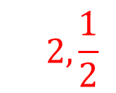
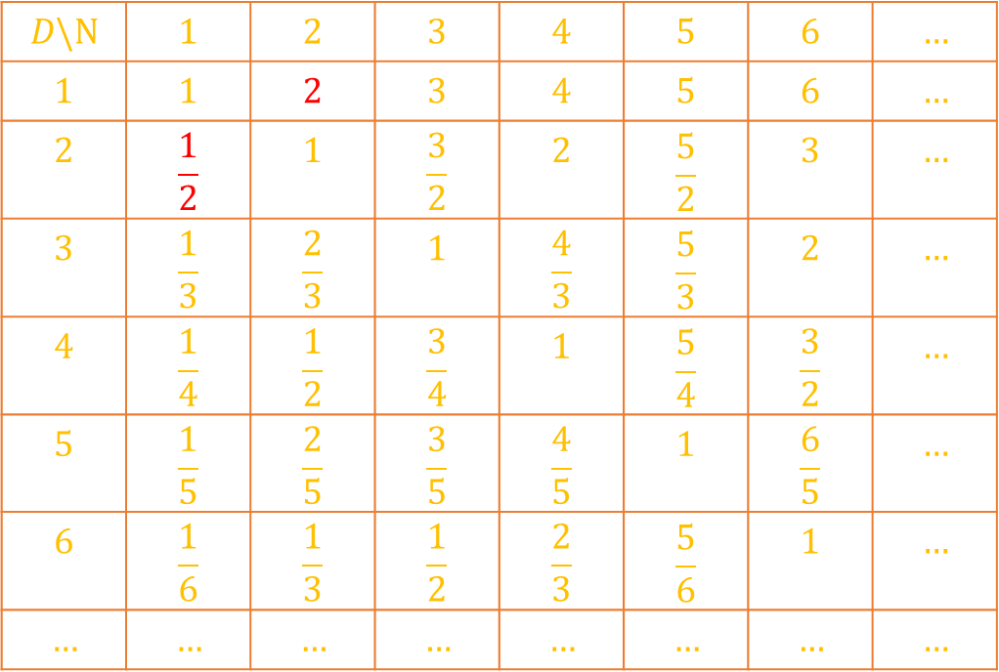
The countability of
the rational numbers
$$D\backslash N$$ | $$1$$ | $$2$$ | $$3$$ | $$4$$ | $$5$$ | $$6$$ | $$…$$
$$1$$ | $$1$$ | $$2$$ | $$3$$ | $$4$$ | $$5$$ | $$6$$ | $$…$$
$$2$$ | $$\frac{1}{2}$$ | $$1$$ | $$\frac{3}{2}$$ | $$2$$ | $$\frac{5}{2}$$ | $$3$$ | $$…$$
$$3$$ | $$\frac{1}{3}$$ | $$\frac{2}{3}$$ | $$1$$ | $$\frac{4}{3}$$ | $$\frac{5}{3}$$ | $$2$$ | $$…$$
$$4$$ | $$\frac{1}{4}$$ | $$\frac{1}{2}$$ | $$\frac{3}{4}$$ | $$1$$ | $$\frac{5}{4}$$ | $$\frac{3}{2}$$ | $$…$$
$$5$$ | $$\frac{1}{5}$$ | $$\frac{2}{5}$$ | $$\frac{3}{5}$$ | $$\frac{4}{5}$$ | $$1$$ | $$\frac{6}{5}$$ | $$…$$
$$6$$ | $$\frac{1}{6}$$ | $$\frac{1}{3}$$ | $$\frac{1}{2}$$ | $$\frac{2}{3}$$ | $$\frac{5}{6}$$ | $$1$$ | $$…$$
$$…$$ | $$…$$ | $$…$$ | $$…$$ | $$…$$ | $$…$$ | $$…$$ | $$…$$
Rational numbers:
$$1,2,\frac{1}{2}$$

Slide 25
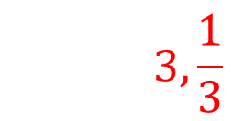
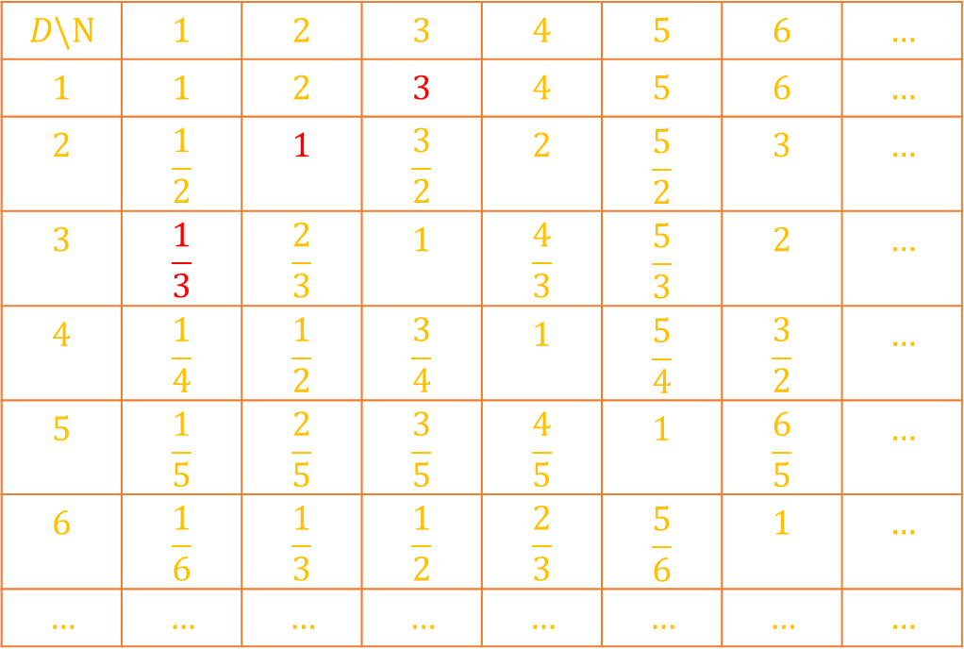
The countability of
the rational numbers
$$D\backslash N$$ | $$1$$ | $$2$$ | $$3$$ | $$4$$ | $$5$$ | $$6$$ | $$…$$
$$1$$ | $$1$$ | $$2$$ | $$3$$ | $$4$$ | $$5$$ | $$6$$ | $$…$$
$$2$$ | $$\frac{1}{2}$$ | $$1$$ | $$\frac{3}{2}$$ | $$2$$ | $$\frac{5}{2}$$ | $$3$$ | $$…$$
$$3$$ | $$\frac{1}{3}$$ | $$\frac{2}{3}$$ | $$1$$ | $$\frac{4}{3}$$ | $$\frac{5}{3}$$ | $$2$$ | $$…$$
$$4$$ | $$\frac{1}{4}$$ | $$\frac{1}{2}$$ | $$\frac{3}{4}$$ | $$1$$ | $$\frac{5}{4}$$ | $$\frac{3}{2}$$ | $$…$$
$$5$$ | $$\frac{1}{5}$$ | $$\frac{2}{5}$$ | $$\frac{3}{5}$$ | $$\frac{4}{5}$$ | $$1$$ | $$\frac{6}{5}$$ | $$…$$
$$6$$ | $$\frac{1}{6}$$ | $$\frac{1}{3}$$ | $$\frac{1}{2}$$ | $$\frac{2}{3}$$ | $$\frac{5}{6}$$ | $$1$$ | $$…$$
$$…$$ | $$…$$ | $$…$$ | $$…$$ | $$…$$ | $$…$$ | $$…$$ | $$…$$
Rational numbers:
$$1,2,\frac{1}{2},3,\frac{1}{3}$$

Slide 26
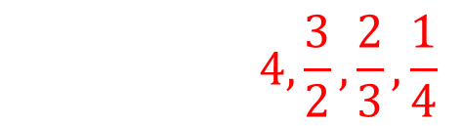
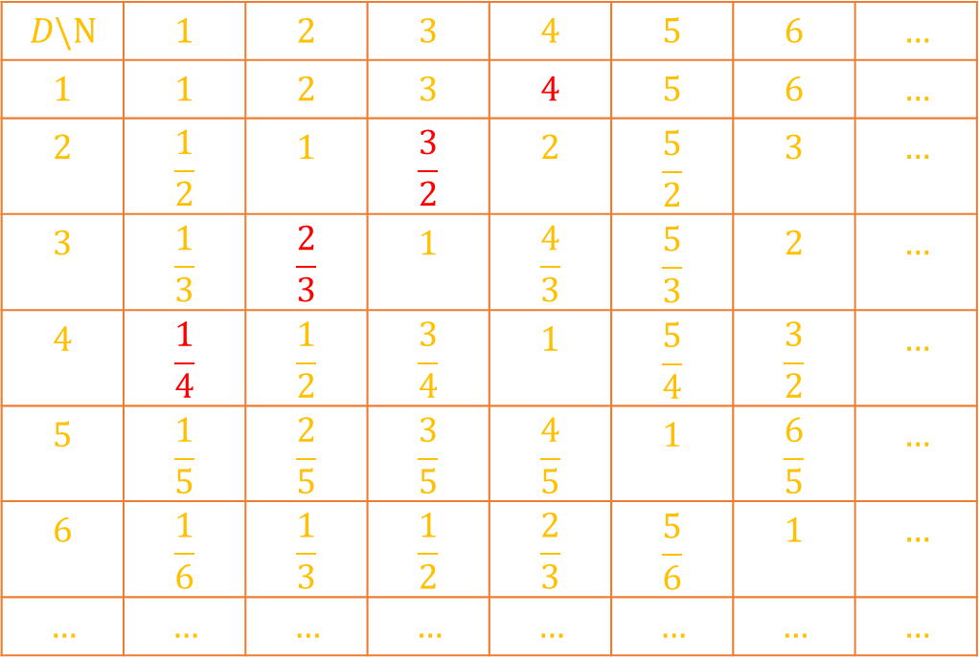
The countability of
the rational numbers
$$D\backslash N$$ | $$1$$ | $$2$$ | $$3$$ | $$4$$ | $$5$$ | $$6$$ | $$…$$
$$1$$ | $$1$$ | $$2$$ | $$3$$ | $$4$$ | $$5$$ | $$6$$ | $$…$$
$$2$$ | $$\frac{1}{2}$$ | $$1$$ | $$\frac{3}{2}$$ | $$2$$ | $$\frac{5}{2}$$ | $$3$$ | $$…$$
$$3$$ | $$\frac{1}{3}$$ | $$\frac{2}{3}$$ | $$1$$ | $$\frac{4}{3}$$ | $$\frac{5}{3}$$ | $$2$$ | $$…$$
$$4$$ | $$\frac{1}{4}$$ | $$\frac{1}{2}$$ | $$\frac{3}{4}$$ | $$1$$ | $$\frac{5}{4}$$ | $$\frac{3}{2}$$ | $$…$$
$$5$$ | $$\frac{1}{5}$$ | $$\frac{2}{5}$$ | $$\frac{3}{5}$$ | $$\frac{4}{5}$$ | $$1$$ | $$\frac{6}{5}$$ | $$…$$
$$6$$ | $$\frac{1}{6}$$ | $$\frac{1}{3}$$ | $$\frac{1}{2}$$ | $$\frac{2}{3}$$ | $$\frac{5}{6}$$ | $$1$$ | $$…$$
$$…$$ | $$…$$ | $$…$$ | $$…$$ | $$…$$ | $$…$$ | $$…$$ | $$…$$
Rational numbers:
$$1,2,\frac{1}{2},3,\frac{1}{3},4,\frac{3}{2},\frac{2}{3},\frac{1}{4}$$

Slide 27
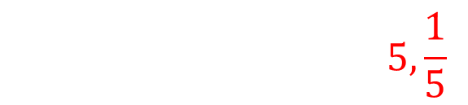
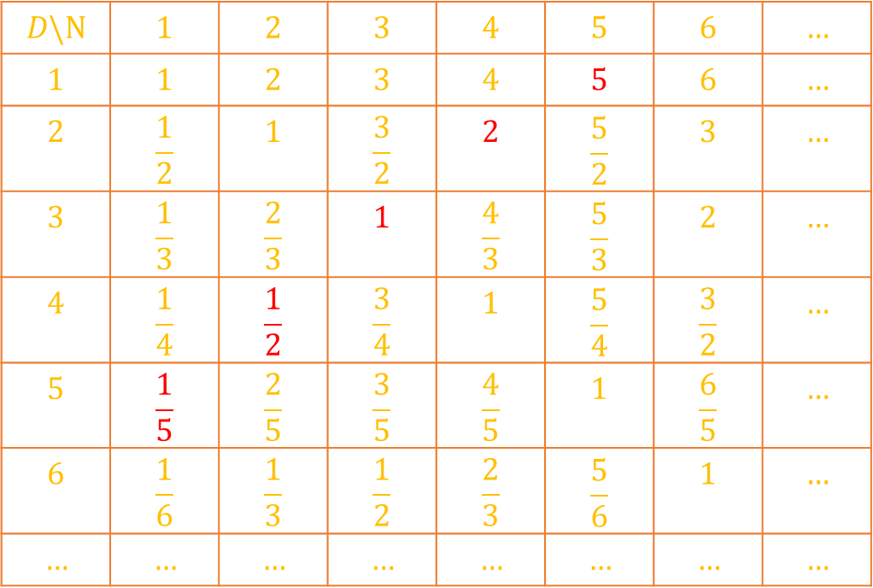
The countability of
the rational numbers
$$D\backslash N$$ | $$1$$ | $$2$$ | $$3$$ | $$4$$ | $$5$$ | $$6$$ | $$…$$
$$1$$ | $$1$$ | $$2$$ | $$3$$ | $$4$$ | $$5$$ | $$6$$ | $$…$$
$$2$$ | $$\frac{1}{2}$$ | $$1$$ | $$\frac{3}{2}$$ | $$2$$ | $$\frac{5}{2}$$ | $$3$$ | $$…$$
$$3$$ | $$\frac{1}{3}$$ | $$\frac{2}{3}$$ | $$1$$ | $$\frac{4}{3}$$ | $$\frac{5}{3}$$ | $$2$$ | $$…$$
$$4$$ | $$\frac{1}{4}$$ | $$\frac{1}{2}$$ | $$\frac{3}{4}$$ | $$1$$ | $$\frac{5}{4}$$ | $$\frac{3}{2}$$ | $$…$$
$$5$$ | $$\frac{1}{5}$$ | $$\frac{2}{5}$$ | $$\frac{3}{5}$$ | $$\frac{4}{5}$$ | $$1$$ | $$\frac{6}{5}$$ | $$…$$
$$6$$ | $$\frac{1}{6}$$ | $$\frac{1}{3}$$ | $$\frac{1}{2}$$ | $$\frac{2}{3}$$ | $$\frac{5}{6}$$ | $$1$$ | $$…$$
$$…$$ | $$…$$ | $$…$$ | $$…$$ | $$…$$ | $$…$$ | $$…$$ | $$…$$
Rational numbers:
$$1,2,\frac{1}{2},3,\frac{1}{3},4,\frac{3}{2},\frac{2}{3},\frac{1}{4},5,\frac{1}{5}$$

Slide 28
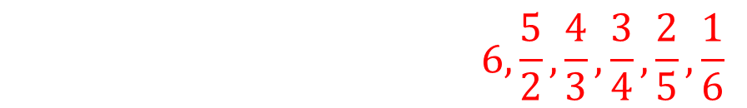
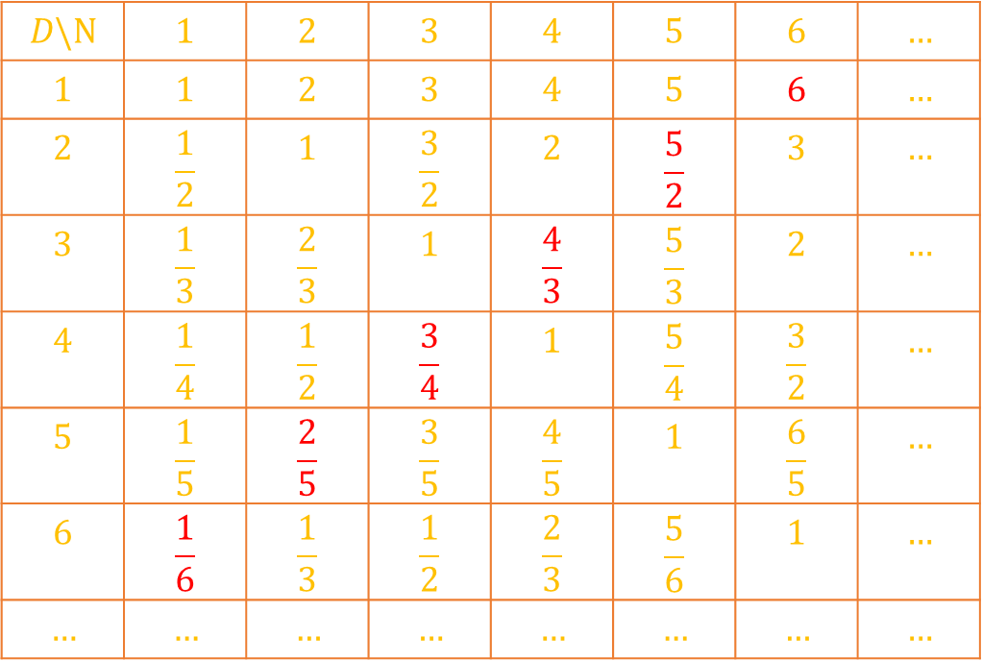
The countability of
the rational numbers
$$D\backslash N$$ | $$1$$ | $$2$$ | $$3$$ | $$4$$ | $$5$$ | $$6$$ | $$…$$
$$1$$ | $$1$$ | $$2$$ | $$3$$ | $$4$$ | $$5$$ | $$6$$ | $$…$$
$$2$$ | $$\frac{1}{2}$$ | $$1$$ | $$\frac{3}{2}$$ | $$2$$ | $$\frac{5}{2}$$ | $$3$$ | $$…$$
$$3$$ | $$\frac{1}{3}$$ | $$\frac{2}{3}$$ | $$1$$ | $$\frac{4}{3}$$ | $$\frac{5}{3}$$ | $$2$$ | $$…$$
$$4$$ | $$\frac{1}{4}$$ | $$\frac{1}{2}$$ | $$\frac{3}{4}$$ | $$1$$ | $$\frac{5}{4}$$ | $$\frac{3}{2}$$ | $$…$$
$$5$$ | $$\frac{1}{5}$$ | $$\frac{2}{5}$$ | $$\frac{3}{5}$$ | $$\frac{4}{5}$$ | $$1$$ | $$\frac{6}{5}$$ | $$…$$
$$6$$ | $$\frac{1}{6}$$ | $$\frac{1}{3}$$ | $$\frac{1}{2}$$ | $$\frac{2}{3}$$ | $$\frac{5}{6}$$ | $$1$$ | $$…$$
$$…$$ | $$…$$ | $$…$$ | $$…$$ | $$…$$ | $$…$$ | $$…$$ | $$…$$
Rational numbers:
$$1,2,\frac{1}{2},3,\frac{1}{3},4,\frac{3}{2},\frac{2}{3},\frac{1}{4},5,\frac{1}{5},6,\frac{5}{2},\frac{4}{3},\frac{3}{4},\frac{2}{5},\frac{1}{6}$$

Slide 29
The countability of
the rational numbers
Proof that Rational Numbers are Countable:
We will use the diagonal method:

Slide 30
The countability of
the rational numbers
Proof that Rational Numbers are Countable:
We will use the diagonal method:
Positive rational numbers:
$$1$$ | $$2$$ | $$\frac{1}{2}$$ | $$3$$ | $$\frac{1}{3}$$ | $$4$$ | $$\frac{3}{2}$$ | $$\frac{2}{3}$$ | $$\frac{1}{4}$$ | $$5$$ | $$\frac{1}{5}$$ | $$6$$ | $$\frac{5}{2}$$ | $$\frac{4}{3}$$ | $$\frac{3}{4}$$ | $$\frac{2}{5}$$ | $$\frac{1}{6}$$ | $$…$$
$$1$$ | $$2$$ | $$3$$ | $$4$$ | $$5$$ | $$6$$ | $$7$$ | $$8$$ | $$9$$ | $$10$$ | $$11$$ | $$12$$ | $$13$$ | $$14$$ | $$15$$ | $$16$$ | $$17$$ | $$…$$

Slide 31
The countability of
the rational numbers
Proof that Rational Numbers are Countable:
We will use the diagonal method:
Positive rational numbers:
$$1$$ | $$2$$ | $$\frac{1}{2}$$ | $$3$$ | $$\frac{1}{3}$$ | $$4$$ | $$\frac{3}{2}$$ | $$\frac{2}{3}$$ | $$\frac{1}{4}$$ | $$5$$ | $$\frac{1}{5}$$ | $$6$$ | $$\frac{5}{2}$$ | $$\frac{4}{3}$$ | $$\frac{3}{4}$$ | $$\frac{2}{5}$$ | $$\frac{1}{6}$$ | $$…$$
$$1$$ | $$2$$ | $$3$$ | $$4$$ | $$5$$ | $$6$$ | $$7$$ | $$8$$ | $$9$$ | $$10$$ | $$11$$ | $$12$$ | $$13$$ | $$14$$ | $$15$$ | $$16$$ | $$17$$ | $$…$$
We can enumerate all positive rational numbers using natural numbers,
so they have the same amount of numbers (the same cardinality).

Slide 32
The countability of
the rational numbers
Proof that Rational Numbers are Countable:
We will use the diagonal method:
Positive rational numbers:
$$1$$ | $$2$$ | $$\frac{1}{2}$$ | $$3$$ | $$\frac{1}{3}$$ | $$4$$ | $$\frac{3}{2}$$ | $$\frac{2}{3}$$ | $$\frac{1}{4}$$ | $$5$$ | $$\frac{1}{5}$$ | $$6$$ | $$\frac{5}{2}$$ | $$\frac{4}{3}$$ | $$\frac{3}{4}$$ | $$\frac{2}{5}$$ | $$\frac{1}{6}$$ | $$…$$
$$1$$ | $$2$$ | $$3$$ | $$4$$ | $$5$$ | $$6$$ | $$7$$ | $$8$$ | $$9$$ | $$10$$ | $$11$$ | $$12$$ | $$13$$ | $$14$$ | $$15$$ | $$16$$ | $$17$$ | $$…$$
We can enumerate all positive rational numbers using natural numbers,
so they have the same amount of numbers (the same cardinality).
For all rationals (positive, negative and zero) we can show equinumerousity
with integers, and equinumerousity between integers and natural numbers
is already known to us.

